Slide 1

Process Mining Virtual Internship
by
C.Pavan Sai
Roll No. 214G1A3273
Department of Computer Science and Engineering (Data Science)
Srinivasa Ramanujan Institute of Technology
(Affiliated to JNTUA & Approved by AICTE) (Accredited by NAAC with ‘A’ Grade & Accredited by NBA (EEE, ECE & CSE)
Rotarypuram Village, B K Samudram Mandal, Ananthapuramu – 515701.
2023 - 2024

Slide 2

Contents
Course Objective
Introduction
Technology
Applications
Modules
Real Time applications
Learning outcomes
GitHub Link
Queries

Slide 3
Course Objective
The course explains the key analysis techniques in process mining Participants will learn various process discovery algorithms. These can be used to automatically learn process models from raw event data.
Have a good understanding of Business process intelligence techniques.
Be able to apply basic process discovery techniques to learn a process model from an event log(both manually and using tools).

Slide 4
Introduction
Process mining is a powerful methodology that bridges the gap between data science and business process management. It's a set of techniques and tools that enable organizations to gain insights into their operational processes by analyzing the data generated during the execution of these processes. This data is often captured in event logs that record each step and action taken within a process.
Imagine a company's various processes order fulfillment, loan approval, customer support, and more—as intricate pathways that involve multiple steps, decisions, and interactions. Process mining helps organizations understand these pathways in a visual and data-driven manner, leading to improved efficiency, enhanced compliance, and better decision-making

Slide 5
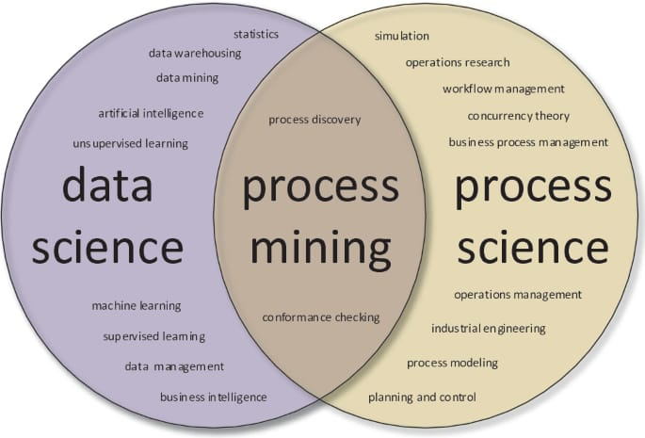
Contd..
Process Mining is a technique designed to discover, monitor and improve real processes extracting readily available knowledge from the event logs of information systems.
Process Mining involves both the Data Science and Process Science.

Slide 6
Technology
Technology used in Process Mining Includes:
Robotic Process Automation (RPA) that helps workers focus on high-value tasks by eliminating tedious steps from a process.
Data science to discover, validate and improve workflows.
Specialized data mining algorithms that are applied to event log data in order to identify trends, patterns and details contained in event logs recorded by an information system.
Artificial Intelligence, computer vision, neural nets, predictive analytics, etc., which are the flag-bearing technologies of this new evolved phase of process mining- a cognitive process discovery.

Slide 7
Applications
Telecommunication: When telecom companies get more orders, process mining gives them the chance to identify pricey issues and client blowback in their Order-to-Activation processes.
Healthcare: Process mining supports the delivery of effective and high-quality end-to-end patient journeys for healthcare organizations dealing with the exponential growth of data.
Financial Services: Companies in the financial services sector have the chance to continually and thoroughly identify issues within high-volume processes thanks to process mining.

Slide 8
Modules
Rising Star Technical
Process Mining
Process Mining
Fundamentals
EMS

Slide 9
Contd..
Data Extraction:
Extract event log data from various sources such as ERP systems, databases, or application logs.
Data Preparation:
Clean and preprocess the data to ensure accuracy and consistency.
Process Discovery:
Use Celonis algorithms to automatically generate a visual process model.
Conformance Analysis:
Compare the discovered process model with actual event data to identify discrepancies.
Root Cause Analysis:
Identify the root causes of process inefficiencies and deviations.
Enhancement and Actionable Insights:
Utilize Celonis to suggest process improvements, leading to enhanced efficiency and better outcomes.

Slide 10
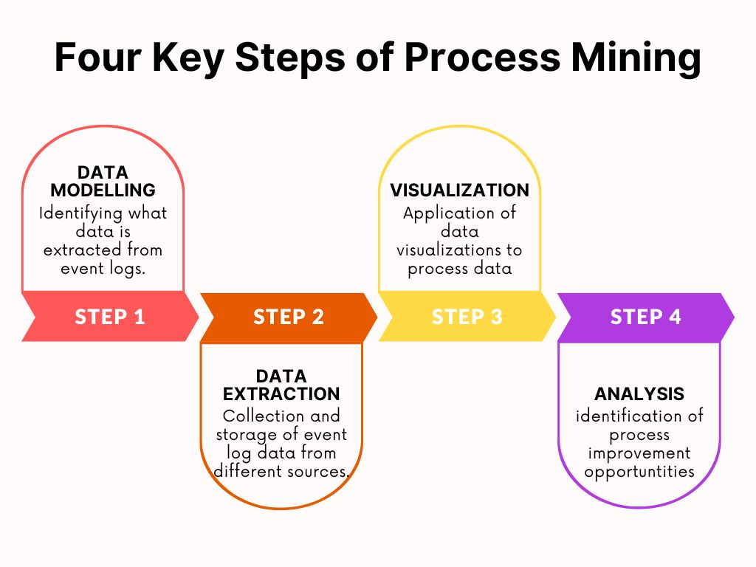
Main Stages in Process Mining:
Data Modelling.
Data Extraction.
Data Visualization.
Data Analysis.

Slide 11
Real Time Applications
Personal Time Management: Process mining can help analyze your daily routines and activities, revealing patters and inefficiencies that could be optimized for better time management.
Cooking and Meal Planning: Process mining analyze your cooking processes and meal planning habits, helping you streamline your cooking routines and discover new recipes.
Study and Learning: Process mining can assist in analyzing your study habits, identifying areas for improvement, and suggesting effective learning strategies.

Slide 12
Learning Outcomes
This Internships allow us to gain experience prior to searching for full-time employment.
To examine the types of the data to be mined and present a general classification of tasks and primitives to integrate a data mining system.
To helps to work with the data and process it to apply on real world applications to make application feasible and to improve the soft skills of learners.

Slide 13
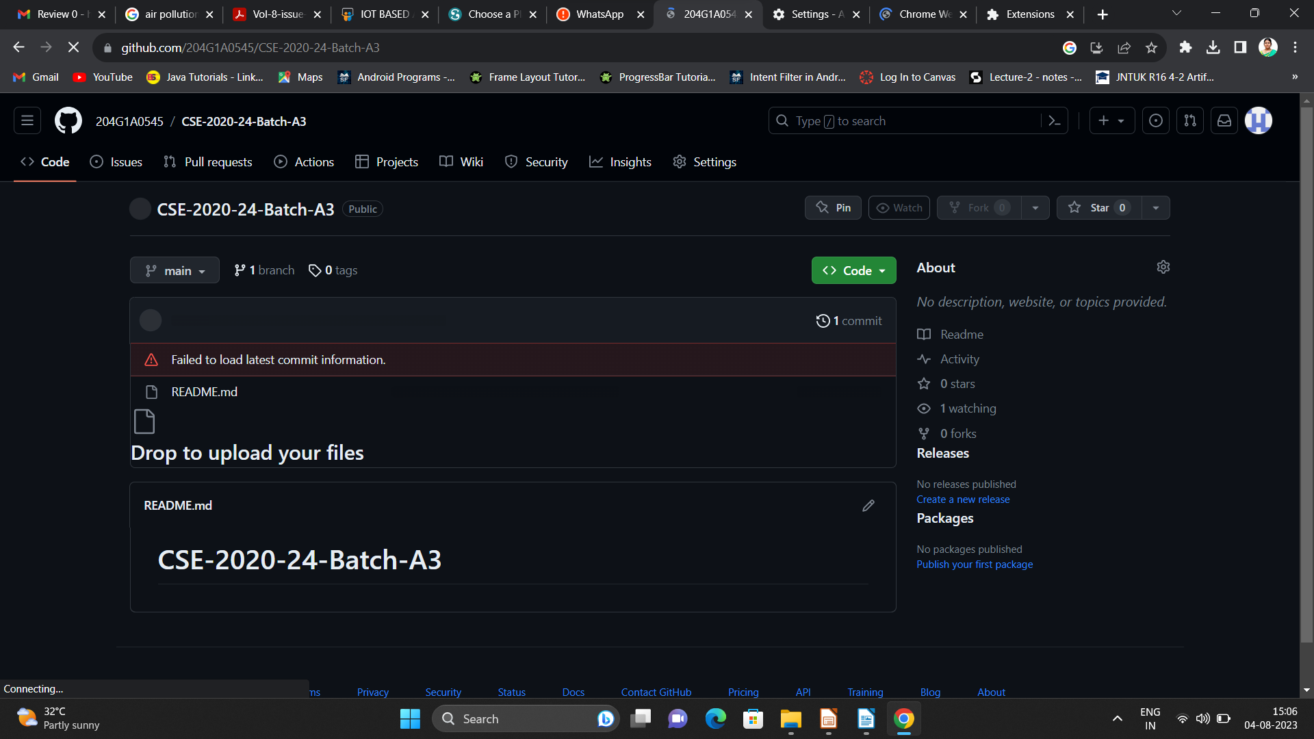

Git Hub Dashboard
Repository Name Like: Summer Internship - I
Under that include document, presentation and Certificate(Pdf).

Slide 14
Any Queries?

Slide 15
Thank You!!!

